Slide 1
Vector Mechanics For Engineers: Dynamics Twelfth Edition
Copyright © 2020 McGraw Hill , All Rights Reserved.
PROPRIETARY MATERIAL © 2020 The McGraw Hill Inc. All rights reserved. No part of this PowerPoint slide may be displayed, reproduced or distributed in any form or by any means, without the prior written permission of the publisher, or used beyond the limited distribution to teachers and educators permitted by McGraw Hill for their individual course preparation. If you are a student using this PowerPoint slide, you are using it without permission.

Slide 2

Chapter 11
Kinematics of Particles

Slide 3
Chapter 11
Vector Mechanics For Engineers: Dynamics
Twelfth Edition
Kinematics of Particles
©Mario Eder/ Getty Images RF
© 2019 McGraw-Hill Education. All rights reserved. Authorized only for instructor use in the classroom. No reproduction or further distribution permitted without the prior written consent of McGraw-Hill Education.

Slide 4
Contents
Introduction
Rectilinear Motion: Position, Velocity & Acceleration
Determining the Motion of a Particle
Sample Problem 11.2
Sample Problem 11.3
Uniform Rectilinear-Motion
Uniformly Accelerated Rectilinear-Motion
Motion of Several Particles: Relative Motion
Sample Problem 11.5
Motion of Several Particles: Dependent Motion
Sample Problem 11.7
Graphical Solutions
Curvilinear Motion: Position, Velocity & Acceleration
Derivatives of Vector Functions
Rectangular Components of Velocity and Acceleration
Sample Problem 11.10
Motion Relative to a Frame in Translation
Sample Problem 11.14
Tangential and Normal Components
Sample Problem 11.16
Radial and Transverse Components
Sample Problem 11.18

Slide 5
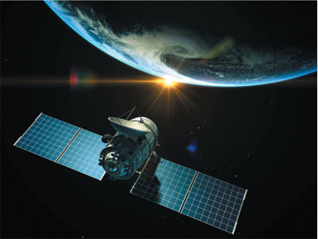
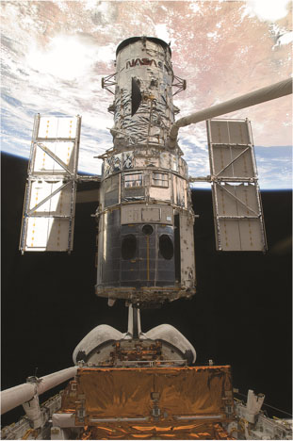
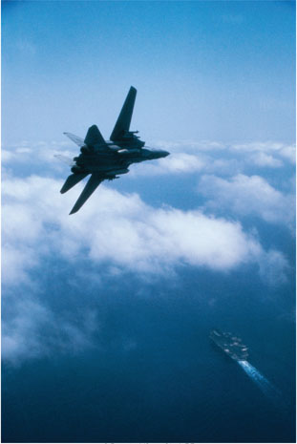
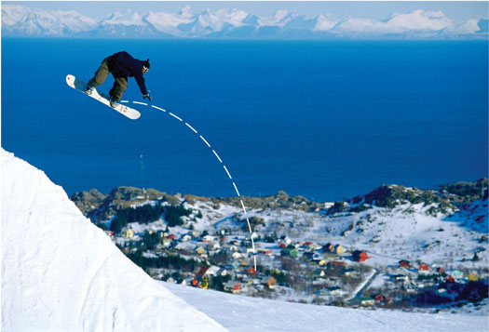
Introduction 1
Kinematic relationships are used to help us determine the trajectory of a snowboarder completing a jump, the orbital speed of a satellite, and accelerations during acrobatic flying.
© iLexx/Getty Images RF, © Purestock/ Superstock RF

Slide 6
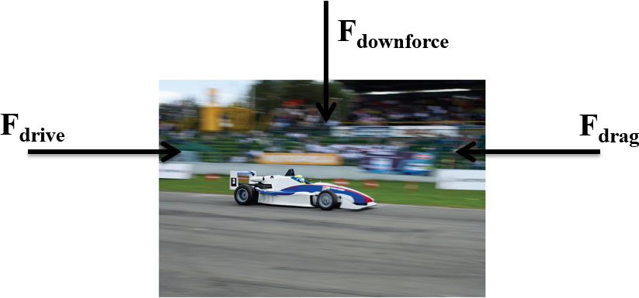
Introduction 2
Dynamics includes:
Kinematics: study of the geometry of motion.
Relates displacement, velocity, acceleration, and time without reference to the cause of motion.
Kinetics: study of the relations existing between the forces acting on a body, the mass of the body, and the motion of the body. Kinetics is used to predict the motion caused by given forces or to determine the forces required to produce a given motion.
© Glow Images RF

Slide 7
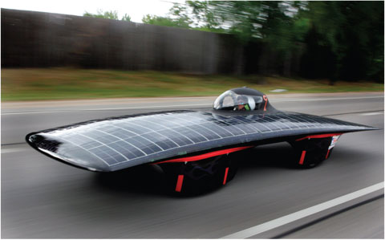
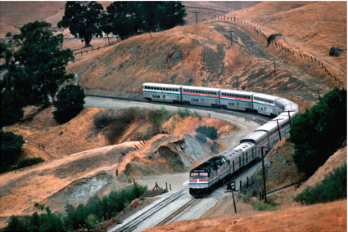
Introduction 3
Particle kinetics includes:
Rectilinear motion: position, velocity, and acceleration of a particle as it moves along a straight line.
Curvilinear motion: position, velocity, and acceleration of a particle as it moves along a curved line in two or three dimensions.
© Tony Hertz/ Alamy

Slide 8
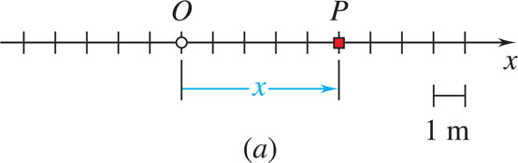
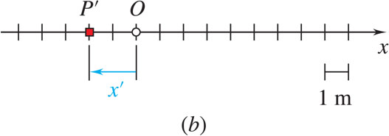
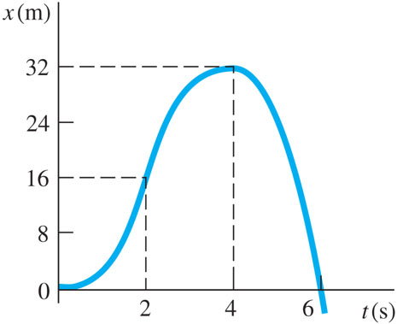
Rectilinear Motion: Position, Velocity & Acceleration 1
Rectilinear motion: particle moving along a straight line
Position coordinate: defined by positive or negative distance from a fixed origin on the line.
The motion of a particle is known if the position coordinate for particle is known for every value of time t.
May be expressed in the form of a function, e.g.,
or in the form of a graph x vs. t.

Slide 9
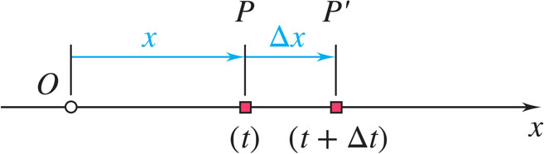
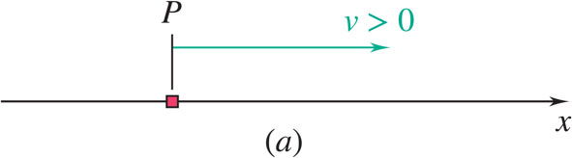
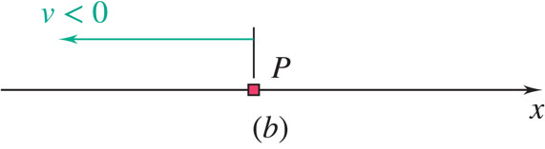
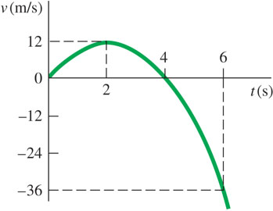
Rectilinear Motion: Position, Velocity & Acceleration 2
Consider particle which occupies position P at time
Instantaneous velocity may be positive or negative. Magnitude of velocity is referred to as particle speed.
From the definition of a derivative,

Slide 10
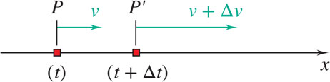
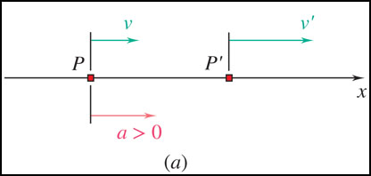
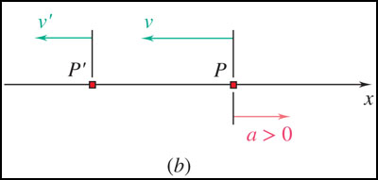
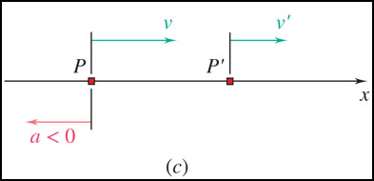
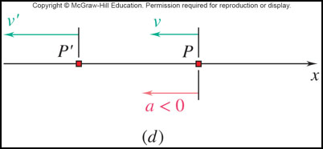
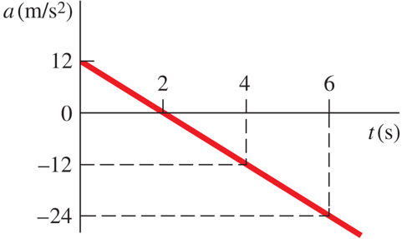
Rectilinear Motion: Position, Velocity & Acceleration 3
Consider particle with velocity v at time t and
Instantaneous acceleration may be:
positive: increasing positive velocity
or decreasing negative velocity
negative: decreasing positive velocity
or increasing negative velocity.
From the definition of a derivative,

Slide 11
Concept Quiz 1
What is true about the kinematics of a particle?
a) The velocity of a particle is always positive
b) The velocity of a particle is equal to the slope of the position-time graph
c) If the position of a particle is zero, then the velocity must zero
d) If the velocity of a particle is zero, then its acceleration must be zero

Slide 12
Concept Quiz 2
What is true about the kinematics of a particle?
a) The velocity of a particle is always positive
b) Answer: The velocity of a particle is equal to the slope of the position-time graph
c) If the position of a particle is zero, then the velocity must zero
d) If the velocity of a particle is zero, then its acceleration must be zero

Slide 13

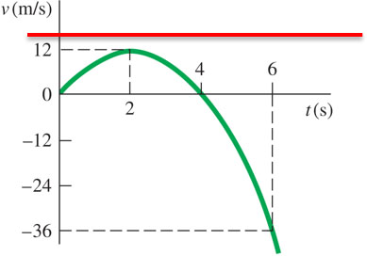

Rectilinear Motion: Position, Velocity & Acceleration
From our example,
What are x, v, and a at t = 2s?
at t = 2 s, x = 16 m, v = v_{max} = 12 m/s, a = 0
Note that v_{max} occurs when a = 0, and that the slope of the velocity curve is zero at this point.
What are x, v, and a at t = 4s?
at t = 4 s, x = x_{max} = 32 m, v = 0, a = −12

Slide 14
Determining the Motion of a Particle
We often determine accelerations from the forces applied (kinetics will be covered later)
Generally have three classes of motion
acceleration given as a function of time, a = f(t).
acceleration given as a function of position, a = f(x).
acceleration given as a function of velocity, a = f(v).
Can you think of a physical example of when force is a function of position?
When force is a function of velocity?
A Spring
Drag

Slide 15
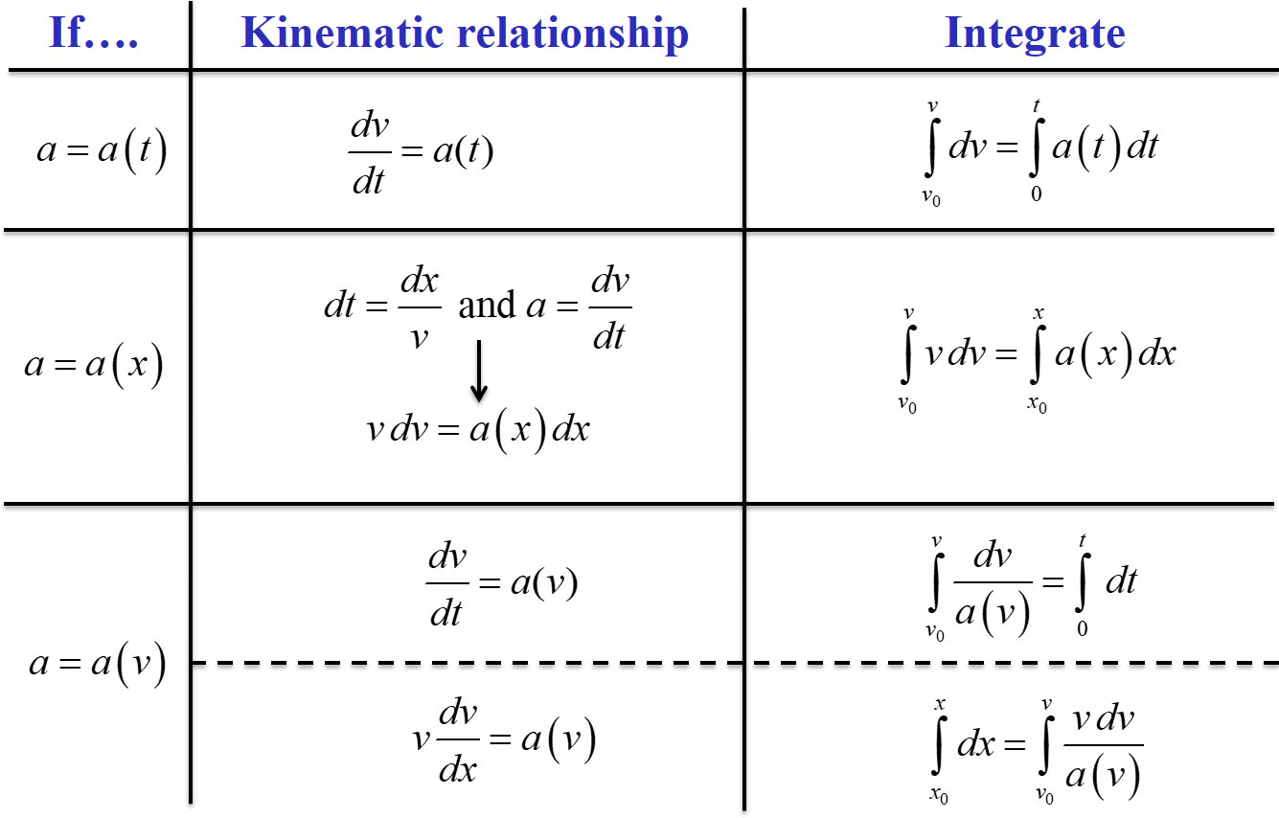
Acceleration as a function of time, position, or velocity

Slide 16
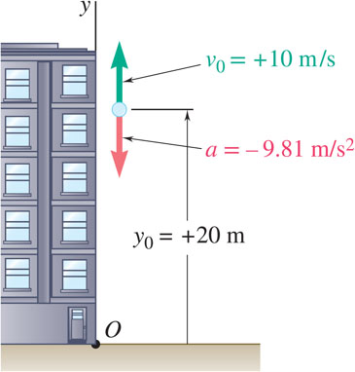
Sample Problem 11.2 1
Strategy:
Acceleration is constant, so we can directly integrate twice to find v(t) and y(t).
Solve for t when velocity equals zero (time for maximum elevation) and evaluate corresponding altitude.
Ball tossed with 10 m/s vertical velocity from window 20 m above ground.
Solve for t when altitude equals zero (time for ground impact) and evaluate corresponding velocity.
Determine:
velocity and elevation above ground at time t,
highest elevation reached by ball and corresponding time, and
time when ball will hit the ground and corresponding velocity.

Slide 17
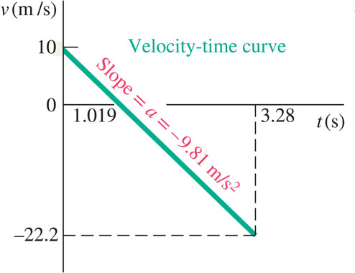
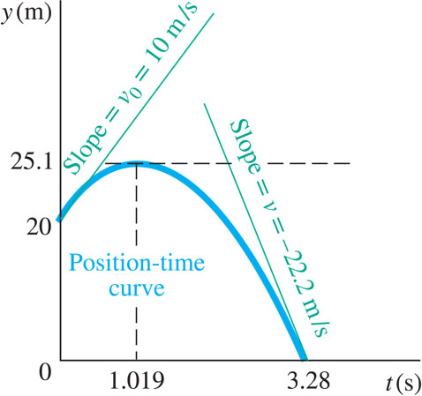
Sample Problem 11.2 2
Modeling and Analysis:
Integrate twice to find v(t) and y(t).

Slide 18
Sample Problem 11.2 3
To find the highest elevation reached, first solve for t when velocity equals zero.
Now evaluate the altitude at the time corresponding to zero vertical velocity.

Slide 19
Sample Problem 11.2 4
To find the velocity when the ball hits the ground, first solve for t when altitude equals zero, and then evaluate the velocity at that time.
Reflect and Think:
When the acceleration is constant, the velocity
changes linearly, and the position is a quadratic function of time.

Slide 20
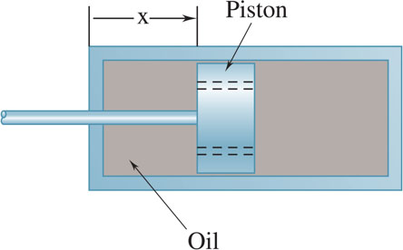
Sample Problem 11.3 1
Strategy:
Which equation we integrate depends on the independent variable of what we wish to calculate: to find functions of time we integrate
a = −kv
while to find functions of position we integrate
A mountain bike shock mechanism used to provide shock absorption consists of a piston that travels in an oil-filled cylinder. As the cylinder is given an initial velocity v₀, the piston moves and oil is forced through orifices in piston, causing piston and cylinder to decelerate at rate proportional to their velocity. Determine v(t), x(t), and v(x).
Integrate
Integrate
Integrate

Slide 21
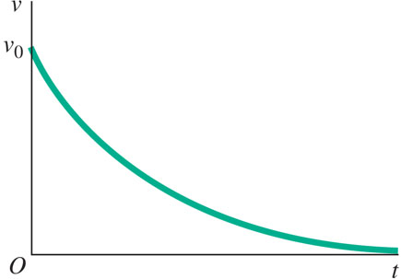
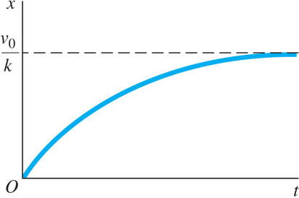
Sample Problem 11.3 2
Modeling and Analysis:
Integrate
Integrate

Slide 22
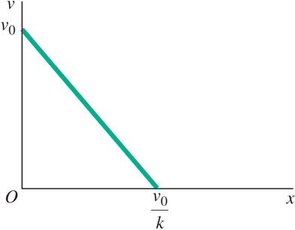
Sample Problem 11.3 3
Integrate

Slide 23
Sample Problem 11.3 4
Reflect and Think:
You could have solved part c by eliminating t from the answers obtained for parts a and b. You could use this alternative method as a check. From part a, you obtain
; substituting into the answer of part b, you have:
v=v₀−kx (checks)

Slide 24
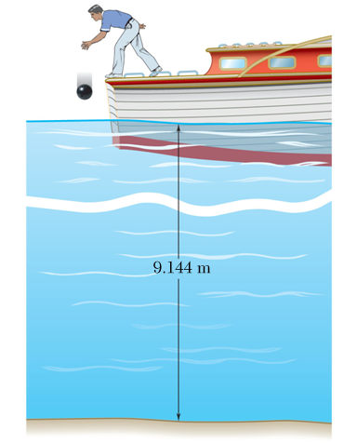
Group Problem Solving 1
A bowling ball is dropped from a boat so that it strikes the surface of a lake with a speed of 8 m/s. Assuming the ball experiences a downward acceleration of a = 3 - 0.1v² when in the water, determine the velocity of the ball when it strikes the bottom of the lake. (a and v expressed in m/s² and m/s respectively)
Which integral should you choose?
(a)
(c)
(b)
(d)

Slide 25
Concept Question
When will the bowling ball start slowing down?
A bowling ball is dropped from a boat so that it strikes the surface of a lake with a speed of 8 m/s. Assuming the ball experiences a downward acceleration of a = 3 - 0.1v² when in the water, determine the velocity of the ball when it strikes the bottom of the lake.
+y
The velocity would have to be high enough for the 0.1 v² term to be bigger than 3.

Slide 26
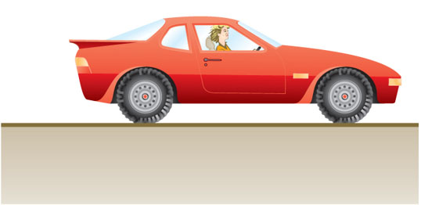
Group Problem Solving 3
Strategy:
Determine the proper kinematic relationship to apply (is acceleration a function of time, velocity, or position?
The car starts from rest and accelerates according to the relationship
Determine the total distance the car travels in one-half lap
Integrate to determine the velocity after one-half lap
It travels around a circular track that has a radius of 200 meters. Calculate the velocity of the car after it has travelled halfway around the track. What is the car’s maximum possible speed?

Slide 27
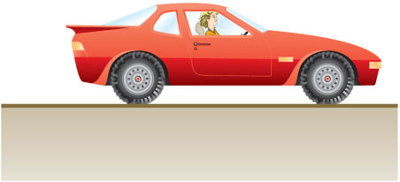
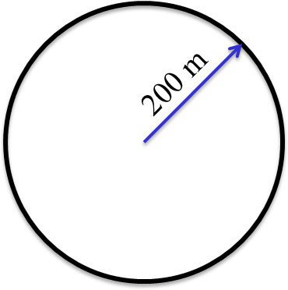
Group Problem Solving 4
Given:
Find: v after
lap
Maximum speed
Modeling and Analysis:
Choose the proper kinematic relationship
Acceleration is a function of velocity, and we also can determine distance. Time is not involved in the problem, so we choose:
Determine total distance travelled

Slide 28
Group Problem Solving 5
Determine the full integral, including limits
Evaluate the interval and solve for v
Take the exponential of each side

Slide 29
Group Problem Solving 6
Solve for v
How do you determine the maximum speed the car can reach?
Velocity is a maximum when acceleration is zero
This occurs when

Slide 30
Group Problem Solving 7
Reflect and Think:
The units for the solution are correct. You can also review the answers from the two parts. The maximum speed (part b) should be greater than the speed found for part a.
By inspection, the answers are reasonable.

Slide 31
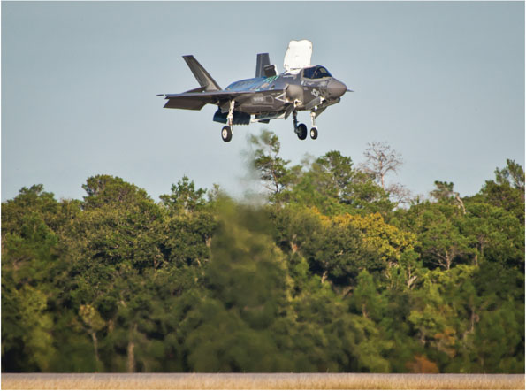
Uniform Rectilinear Motion
Once a safe speed of descent for a vertical landing is reached, a Harrier jet pilot will adjust the vertical thrusters to equal the weight of the aircraft. The plane then travels at a constant velocity downward. If motion is in a straight line, this is uniform rectilinear motion.
For a particle in uniform rectilinear motion, the acceleration is zero and the velocity is constant.
Careful – these only apply to uniform rectilinear motion!

Slide 32
Uniformly Accelerated Rectilinear Motion
For a particle in uniformly accelerated rectilinear motion, the acceleration of the particle is constant. You may recognize these constant acceleration equations from your physics courses.
Careful – these only apply to uniformly accelerated rectilinear motion!

Slide 33
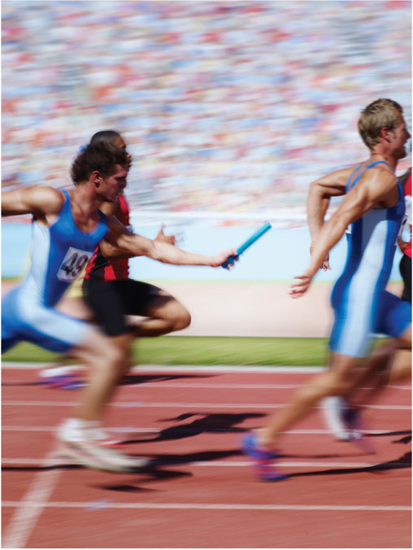
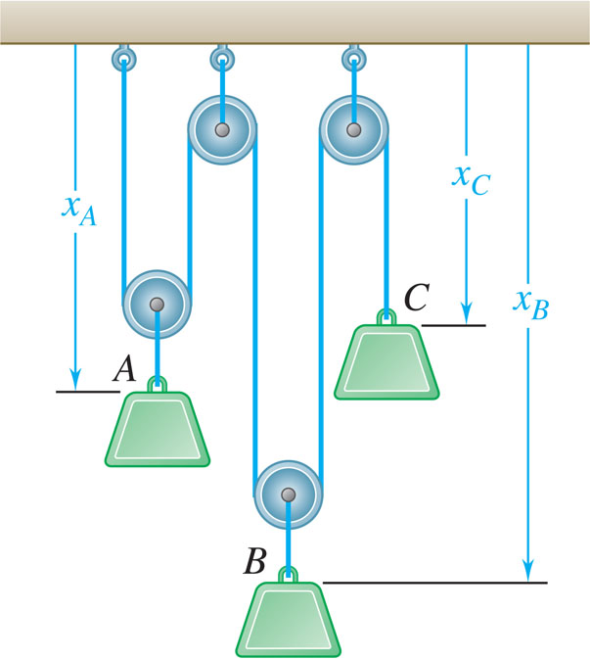
Motion of Several Particles
We may be interested in the motion of several different particles, whose motion may be independent or linked together.

Slide 34
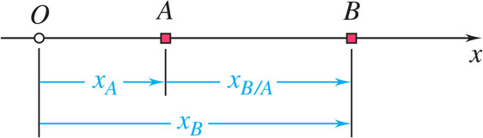
Motion of Several Particles: Relative Motion
For particles moving along the same line, time should be recorded from the same starting instant and displacements should be measured from the same origin in the same direction.
relative position of B with respect to A
relative velocity of B with respect to A
relative acceleration of B with respect to A

Slide 35
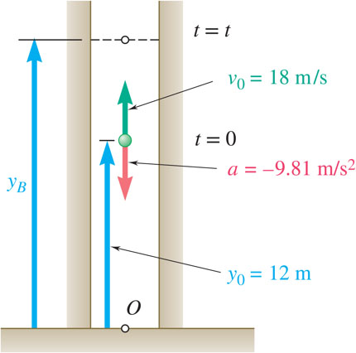
Sample Problem 11.5 1
Strategy:
Substitute initial position and velocity and constant acceleration of ball into general equations for uniformly accelerated rectilinear motion.
Substitute initial position and constant velocity of elevator into equation for uniform rectilinear motion.
Ball thrown vertically from 12 m level in elevator shaft with initial velocity of 18m/s. At same instant, open-platform elevator passes 5 m level moving upward at 2m/s.
Write equation for relative position of ball with respect to elevator and solve for zero relative position, that is, impact.
Determine (a) when and where ball hits elevator and (b) relative velocity of ball and elevator at contact.
Substitute impact time into equation for position of elevator and relative velocity of ball with respect to elevator.

Slide 36
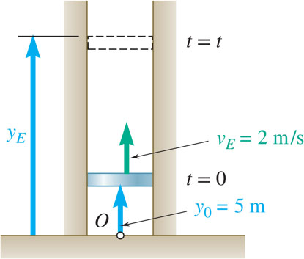
Sample Problem 11.5 2
Modeling and Analysis:
Substitute initial position and velocity and constant acceleration of ball into general equations for uniformly accelerated rectilinear motion.
Substitute initial position and constant velocity of elevator into equation for uniform rectilinear motion.

Slide 37
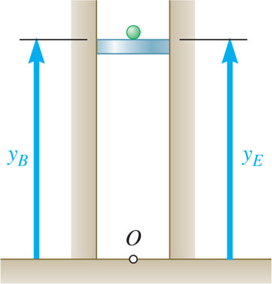
Sample Problem 11.5 3
Write equation for relative position of ball with respect to elevator and solve for zero relative position, i.e., impact.
Substitute impact time into equations for position of elevator and relative velocity of ball with respect to elevator.

Slide 38
Sample Problem 11.5 4
Reflect and Think:
The key insight is that, when two particles collide, their position coordinates must be equal. Also, although you can use the basic kinematic relationships in this problem, you may find it easier to use the equations relating a, v, x, and t when the acceleration is constant or zero.

Slide 39
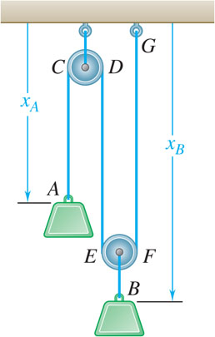

Motion of Several Particles: Dependent Motion
Position of a particle may depend on position of one or more other particles.
Position of block B depends on position of block A. Since rope is of constant length, it follows that sum of lengths of segments must be constant.
constant (one degree of freedom)
Positions of three blocks are dependent.
constant (two degrees of freedom)
For linearly related positions, similar relations hold between velocities and accelerations.

Slide 40
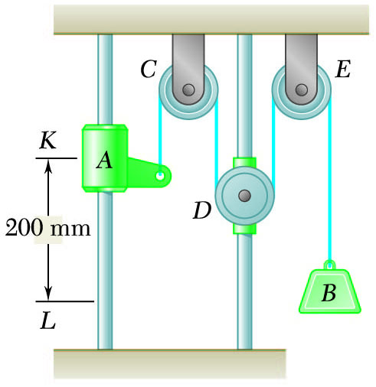
Sample Problem 11.7 1
Strategy:
Define origin at upper horizontal surface with positive displacement downward.
Collar A has uniformly accelerated rectilinear motion. Solve for acceleration and time t to reach L.
Pulley D has uniform rectilinear motion. Calculate change of position at time t.
Pulley D is attached to a collar which is pulled down at 75 mm/s. At t = 0, collar A starts moving down from K with constant acceleration and zero initial velocity. Knowing that velocity of collar A is 300 mm/s as it passes L, determine the change in elevation, velocity, and acceleration of block B when block A is at L.
Block B motion is dependent on motions of collar A and pulley D. Write motion relationship and solve for change of block B position at time t.
Differentiate motion relation twice to develop equations for velocity and acceleration of block B.

Slide 41
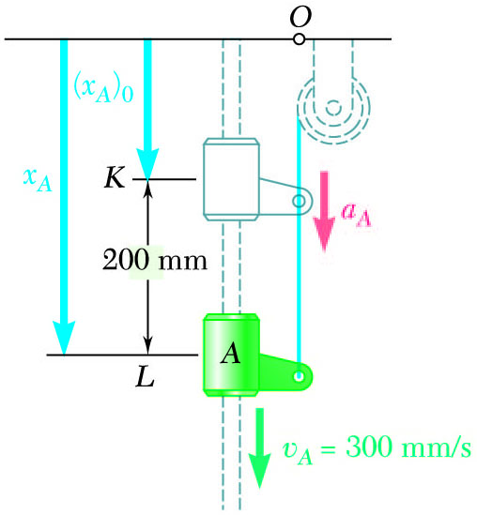
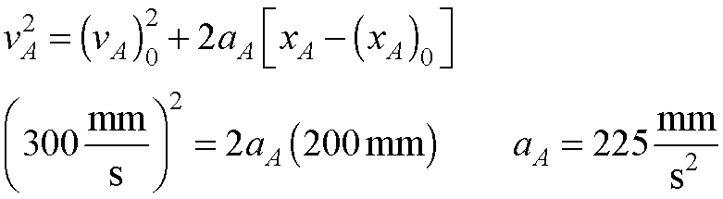
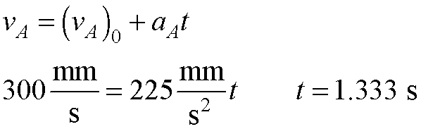
Sample Problem 11.7 2
Modeling and Analysis:
Define origin at upper horizontal surface with positive displacement downward.
Collar A has uniformly accelerated rectilinear motion. Solve for acceleration and time t to reach L.

Slide 42
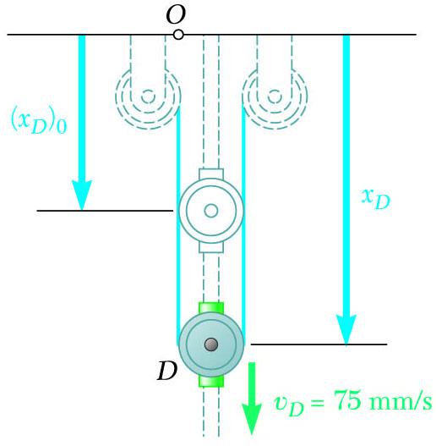
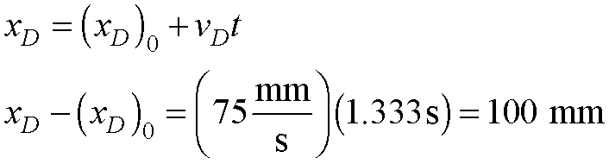
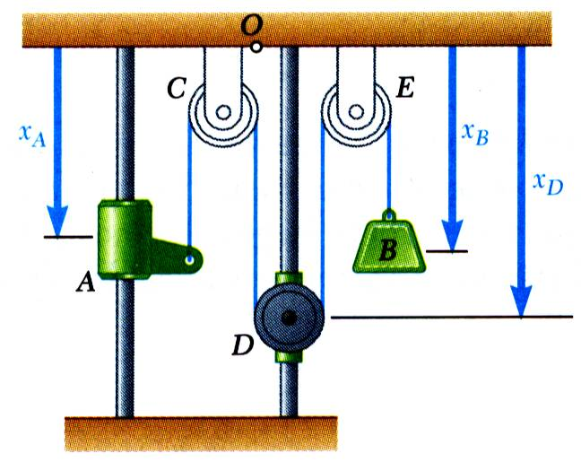
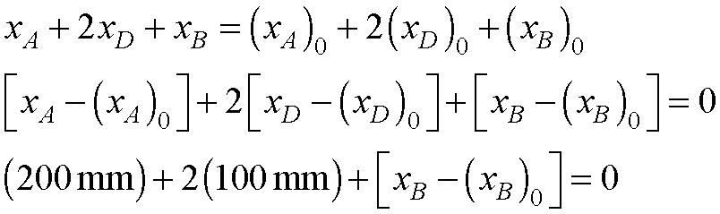
Sample Problem 11.7 3
Pulley D has uniform rectilinear motion. Calculate change of position at time t.
Block B motion is dependent on motions of collar A and pulley D. Write motion relationship and solve for change of block B position at time t.
Total length of cable remains constant,

Slide 43
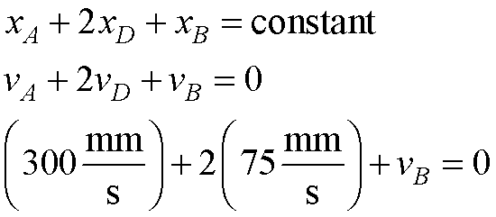

Sample Problem 11.7 4
Differentiate motion relation twice to develop equations for velocity and acceleration of block B.
Reflect and Think:
In this case, the relationship we needed was not between position coordinates, but between changes in position coordinates at two different times. The key step is to clearly define your position vectors. This is a two degree-of-freedom system, because two coordinates are required to completely describe it.

Slide 44

Group Problem Solving 8
Slider block A moves to the left with a constant velocity of 6 m/s. Determine the velocity of block B.
Strategy:
Sketch your system and choose coordinate system.
Write out constraint equation.
Differentiate the constraint equation to get velocity.

Slide 45

Group Problem Solving 9
Given: v_{A}= 6 m/s left Find: v_{B}
This length is constant no matter how the blocks move
Sketch your system and choose coordinates
Define your constraint equation(s)
Differentiate the constraint equation to get velocity
Note that as x_{A} gets bigger, y_{B} gets smaller.

Slide 46

Group Problem Solving 10
Reflect and Think:
Physically it makes sense, by looking at the system, block B must move upward if block A is to move to the left.
The velocity of block B should also be less than that of block A.

Slide 47
Graphical Solutions 1
Engineers often collect position, velocity, and acceleration data. Graphical solutions are often useful in analyzing these data.
Acceleration data from a head impact during a round of boxing.

Slide 48

Graphical Solutions 2
Given the x-t curve, the v-t curve is equal to the x-t curve slope.
Given the v-t curve, the a-t curve is equal to the v-t curve slope.

Slide 49



Graphical Solutions 3
Given the a-t curve, the change in velocity between t₁ and t₂ is equal to the area under the a-t curve between t₁ and t₂.
Given the v-t curve, the change in position between t₁ and t₂ is equal to the area under the v-t curve between t₁ and t₂.

Slide 50
Curvilinear Motion: Position, Velocity & Acceleration 1
The snowboarder and the train both undergo curvilinear motion.
A particle moving along a curve other than a straight line is in curvilinear motion.
© Purestock/ Superstock RF, © Tony Hertz/ Alamy
,

Slide 51

Curvilinear Motion: Position, Velocity & Acceleration 2
The position vector of a particle at time t is defined by a vector between origin O of a fixed reference frame and the position occupied by particle.
Consider a particle which occupies position P defined by
at time t and P′
defined by

Slide 52


Curvilinear Motion: Position, Velocity & Acceleration 3
Instantaneous velocity (vector)
Instantaneous speed (scalar)

Slide 53


Curvilinear Motion: Position, Velocity & Acceleration 4
Consider velocity
of a particle at time t and velocity
instantaneous acceleration (vector)
In general, the acceleration vector is not tangent to the particle path and velocity vector.

Slide 54


Rectangular Components of Velocity & Acceleration 1
When position vector of particle P is given by its rectangular components,
Velocity vector,
Acceleration vector,

Slide 55


Rectangular Components of Velocity & Acceleration 2
Rectangular components particularly effective when component accelerations can be integrated independently, example: motion of a projectile,
with initial conditions,
Integrating twice yields
Motion in horizontal direction is uniform.
Motion in vertical direction is uniformly accelerated.
Motion of projectile could be replaced by two independent rectilinear motions.

Slide 56

Sample Problem 11.10 1
Strategy:
Consider the vertical and horizontal motion separately (they are independent).
Apply equations of motion in y-direction.
Apply equations of motion in x-direction.
A projectile is fired from the edge of a 150-m cliff with an initial velocity of 180 m/s at an angle of 30° with the horizontal. Neglecting air resistance, find (a) the horizontal distance from the gun to the point where the projectile strikes the ground, (b) the greatest elevation above the ground reached by the projectile.
Determine time t for projectile to hit the ground, use this to find the horizontal distance.
Maximum elevation occurs when

Slide 57



Sample Problem 11.10 2
Modeling and Analysis:
Given:
Vertical motion – uniformly accelerated:
Horizontal motion – uniformly accelerated:
Choose positive x to the right as shown

Slide 58

Sample Problem 11.10 3
Modeling and Analysis:
Horizontal distance
Projectile strikes the ground at: y = −150m
Substitute into equation (1) above
Solving for t, we take the positive root
Substitute t into equation (4)
Maximum elevation occurs when
Maximum elevation above the ground = 150m + 413m = 563m

Slide 59

Sample Problem 11.10 4
Reflect and Think:
Because there is no air resistance, you can treat the vertical and horizontal motions separately and can immediately write down the algebraic equations of motion. If you did want to include air resistance, you must know the acceleration as a function of speed (you will see how to derive this in Chapter 12), and then you need to use the basic kinematic relationships, separate variables, and integrate.

Slide 60

Concept Quiz 5
If you fire a projectile from 150 meters above the ground (see Ex Problem 11.10), what launch angle will give you the greatest horizontal distance x?
a) A launch angle of 45°
b) A launch angle less than 45°
c) A launch angle greater than 45°
d) It depends on the launch velocity

Slide 61
Concept Quiz 6
If you fire a projectile from 150 meters above the ground (see Ex Problem 11.10), what launch angle will give you the greatest horizontal distance x?
a) A launch angle of 45°
b) Answer: A launch angle less than 45°
c) A launch angle greater than 45°
d) It depends on the launch velocity

Slide 62

Group Problem Solving 11
Strategy:
Consider the vertical and horizontal motion separately (they are independent)
A baseball pitching machine “throws” baseballs with a horizontal velocity v₀. If you want the height h to be 1050 mm, determine the value of v₀.
Apply equations of motion in y-direction
Apply equations of motion in x-direction
Determine time t for projectile to fall to 1050 mm
Calculate v₀=0

Slide 63
Group Problem Solving 12
Modeling and Analysis:
Given: x= 12.2 m, y_{o} = 1.5 m, y_{f}= 1050 mm.
Find: v_{o}
Analyze the motion in the y-direction
Analyze the motion in the x-direction
Reflect and Think:
Units are correct and magnitudes are reasonable

Slide 64

Motion Relative to a Frame in Translation 1
It is critical for a pilot to know the relative motion of his helicopter with respect to the aircraft carrier to make a safe landing.
© Digital Vision/Getty Images RF

Slide 65

Motion Relative to a Frame in Translation 2
Designate one frame as the fixed frame of reference. All other frames not rigidly attached to the fixed reference frame are moving frames of reference.
Position vectors for particles A and B with respect to the fixed frame of reference Oxyz are
Vector
joining A and B defines the position of
B with respect to the moving frame
Differentiating twice,
velocity of B relative to A.
acceleration of B relative to A.
Absolute motion of B can be obtained by combining motion of A with relative motion of B with respect to moving reference frame attached to A.

Slide 66

Sample Problem 11.14 1
Strategy:
Define inertial axes for the system.
Determine the position, speed, and acceleration of car A at t = 5 s.
Determine the position, speed, and acceleration of car B at t = 5 s.
Automobile A is traveling east at the constant speed of 36 km/h. As automobile A crosses the intersection shown, automobile B starts from rest 35 m north of the intersection and moves south with a constant acceleration of
Using vectors (Equation 11.30, 11.32, and 11.33) or a graphical approach, determine the relative position, velocity, and acceleration.
Determine
the position, velocity, and
acceleration of B relative to A 5 s
after A crosses the intersection.

Slide 67

Sample Problem 11.14 2
Modeling and Analysis:
Define axes along the road,
Given:
Determine motion of Automobile A:
We have uniform motion for A so:
At t = 5 s

Slide 68
Sample Problem 11.14 3
Modeling and Analysis:
Determine motion of Automobile B:
We have uniform acceleration for B so:
At t = 5 s

Slide 69






Sample Problem 11.14 4
We can solve the problems geometrically, and apply the arctangent relationship:
Or we can solve the problems using vectors to obtain equivalent results:
Physically, a rider in car A would “see” car B travelling south and west.

Slide 70

Sample Problem 11.14 5
Reflect and Think:
Note that the relative position and velocity of B relative to A change with time; the values given here are only for the moment t = 5 s.

Slide 71





Concept Quiz 3
If you are sitting in train B looking out the window, it which direction does it appear that train A is moving?
a)
c)
b)
d)

Slide 72
Concept Quiz 4
If you are sitting in train B looking out the window, it which direction does it appear that train A is moving?
a)
c) Answer:
b)
d)

Slide 73


Tangential and Normal Components 1
If we have an idea of the path of a vehicle or object, it is often convenient to analyze the motion using tangential and normal components (sometimes called path coordinates).
© Rusell lllig/Getty Images RF, © Alan Schein/ Getty Images

Slide 74

Tangential and Normal Components 2
ρ = the instantaneous radius of curvature
The tangential direction (e_{t}) is tangent to the path of the particle. This velocity vector of a particle is in this direction.
The normal direction (e_{n}) is perpendicular to e_{t} and points towards the inside of the curve.
The acceleration can have components in both the e_{n} and e_{t} directions.

Slide 75


Tangential and Normal Components 3
To derive the acceleration vector in tangential and normal components, define the motion of a particle as shown in the figure.
are tangential unit vectors for the
particle path at
When drawn with
respect to the same origin,
and
is the angle between them.

Slide 76


Tangential and Normal Components 4
With the velocity vector expressed as
the particle acceleration may be written as
but
After substituting,
The tangential component of acceleration reflects change of speed and the normal component reflects change of direction.
The tangential component may be positive or negative. Normal component always points toward center of path curvature.

Slide 77

Tangential and Normal Components 5
Relations for tangential and normal acceleration also apply for particle moving along a space curve.
The plane containing tangential and normal unit vectors is called the osculating plane.
The normal to the osculating plane is found from
Acceleration has no component along the binormal.

Slide 78

Sample Problem 11.16 1
Strategy:
Define your coordinate system
Calculate the tangential velocity and tangential acceleration
Calculate the normal acceleration
A motorist is traveling on a curved section of highway of radius 750 m at the speed of 90 km/h. The motorist suddenly applies the brakes, causing the automobile to slow down at a constant rate. Knowing that after 8 s the speed has been reduced to 72 km/h, determine the acceleration of the automobile immediately after the brakes have been applied.
Determine overall acceleration magnitude after the brakes have been applied

Slide 79








Sample Problem 11.16 2
Modeling and Analysis:
Define your coordinate system
Determine velocity and acceleration in the tangential direction
The deceleration constant, therefore
Immediately after the brakes are applied, the speed is still 25 m/s

Slide 80
Sample Problem 11.16 3
Reflect and Think:
The tangential component of acceleration is opposite the direction of motion, and the normal component of acceleration points to the center of curvature, which is what you would expect for slowing down on a curved path. Attempting to do the problem in Cartesian coordinates is quite difficult.

Slide 81

Tangential and Normal Components 6
In 2001, a race scheduled at the Texas Motor Speedway was cancelled because the normal accelerations were too high and caused some drivers to experience excessive g-loads (similar to fighter pilots) and possibly pass out. What are some things that could be done to solve this problem?
Some possibilities:
Reduce the allowed speed
Increase the turn radius (difficult and costly)
Have the racers wear g-suits
© Glow Images RF

Slide 82

Group Problem Solving 13
Strategy:
Define your coordinate system.
Calculate the tangential velocity and tangential acceleration.
Calculate the normal acceleration.
The tangential acceleration of the centrifuge cab is given by
Determine overall acceleration magnitude.
where t is in seconds and a_{t} is in
If the centrifuge starts from
rest, determine the total acceleration magnitude of the cab after 10 seconds.

Slide 83


Group Problem Solving 14
Modeling and Analysis:
Define your coordinate system
In the side view, the tangential direction points into the “page”.
Determine the tangential velocity
Determine the normal acceleration
Determine the total acceleration magnitude

Slide 84
Group Problem Solving 15
Reflect and Think:
Notice that the normal acceleration is much higher than the tangential acceleration. What would happen if, for a given tangential velocity and acceleration, the arm radius was doubled?
a) The accelerations would remain the same
b) The a_{n} would increase and the a_{t} would decrease
c) The a_{n} and a_{t} would both increase
d) The a_{n} would decrease

Slide 85
Group Problem Solving 16
Reflect and Think:
Notice that the normal acceleration is much higher than the tangential acceleration. What would happen if, for a given tangential velocity and acceleration, the arm radius was doubled?
a) The accelerations would remain the same
b) The a_{n} would increase and the a_{t} would decrease
c) The a_{n} and a_{t} would both increase
d) Answer: The a_{n} would decrease

Slide 86


Radial and Transverse Components 1
The foot pedal on an elliptical machine rotates about and extends from a central pivot point. This motion can be analyzed using radial and transverse components
Fire truck ladders can rotate as well as extend; the motion of the end of the ladder can be analyzed using radial and transverse components.
© Syracuse Newspapers/M Greenlar/The Image Works, © Fuse/ Getty Images RF

Slide 87

Radial and Transverse Components 2
The position of a particle P is expressed as a distance r from the origin O to P – this defines the radial direction e_{r.} The transverse direction e_{q} is perpendicular to e_{r},
The particle velocity vector is:
The particle acceleration vector is:

Slide 88
Radial and Transverse Components 3
We can derive the velocity and acceleration relationships by recognizing that the unit vectors change direction.
The particle velocity vector is:
Similarly, the particle acceleration vector is:

Slide 89

Concept Quiz 7
If you are travelling in a perfect circle, what is always true about radial/transverse coordinates and normal/tangential coordinates?
a) The e_{r} direction is identical to the e_{n} direction.
b) The e_{q} direction is perpendicular to the e_{n} direction.
c) The e_{q} direction is parallel to the e_{r} direction.

Slide 90
Concept Quiz 8
If you are travelling in a perfect circle, what is always true about radial/transverse coordinates and normal/tangential coordinates?
a) The e_{r} direction is identical to the e_{n} direction.
b) Answer: The e_{q} direction is perpendicular to the e_{n} direction.
c) The e_{q} direction is parallel to the e_{r} direction.

Slide 91


Radial and Transverse Components 4
When particle position is given in cylindrical coordinates, it is convenient to express the velocity and acceleration vectors using the unit vectors
Position vector,
Velocity vector,
Acceleration vector,

Slide 92

Sample Problem 11.18 1
Strategy:
Evaluate time t for θ = 30°.
Evaluate radial and angular positions, and first and second derivatives at time t.
Rotation of the arm about O is defined
Calculate velocity and acceleration in cylindrical coordinates.
is in radians and t
in seconds. Collar B slides along the
Evaluate acceleration with respect to arm.
arm such that
where r is
in meters.
After the arm has rotated through 30° determine (a) the total velocity of the collar, (b) the total acceleration of the collar, and (c) the relative acceleration of the collar with respect to the arm.

Slide 93
Sample Problem 11.18 2
Modeling and Analysis
Evaluate time t for θ = 30°.
Evaluate radial and angular positions, and first and second derivatives at time t.

Slide 94



Sample Problem 11.18 3
Calculate velocity and acceleration.

Slide 95


Sample Problem 11.18 4
Evaluate acceleration with respect to arm.
Motion of collar with respect to arm is rectilinear and defined by coordinate r.
Reflect and Think:
You should consider polar coordinates for any kind of rotational motion. They turn this problem into a straightforward solution, whereas any other coordinate system would make this problem much more difficult. One way to make this problem harder would be to ask you to find the radius of curvature in addition to the velocity and acceleration. To do this, you would have to find the normal component of the acceleration; that is, the component of acceleration that is perpendicular to the tangential direction defined by the velocity vector.

Slide 96

Group Problem Solving 17
Strategy:
Define your coordinate system.
Calculate the angular velocity after three revolutions.
Calculate the radial and transverse accelerations.
Determine overall acceleration magnitude.
The angular acceleration of the centrifuge arm varies according to
Where θ is measured in radians. If the centrifuge starts from rest, determine the acceleration magnitude after the gondola has travelled two full rotations.

Slide 97


Group Problem Solving 18
Modeling and Analysis:
Define your coordinate system
In the side view, the transverse direction points into the “page”
Determine the angular velocity
Acceleration is a function of position, so use:
Evaluate the integral

Slide 98

Group Problem Solving 19
Determine the angular velocity
Determine the angular acceleration
Find the radial and transverse accelerations
Magnitude:

Slide 99

Group Problem Solving 20
Reflect and Think:
What would happen if you designed the centrifuge so that the arm could extend from 6 to 10 meters?
You could now have additional acceleration terms. This might give you more control over how quickly the acceleration of the gondola changes (this is known as the G-onset rate).

Slide 100
End of Chapter 11

